Slide 1
Open Addressing
h₀(x), h₁(x), h₂(x) are tried in succession when collision occurs
where h_{i}(x) = (Hash(x) + F(i)) mod TableSize with F(0) = 0
F(i) is the collision resolution strategy

Slide 2
Open Addressing Techniques
  Linear Probing
  Quadratic Probing
  Double Hashing

Slide 3
Linear probing
0
1 | 41
2 | 21
3
4 | 34
5
6
7 | 7
8 | 18
9 | 57
linear probing: resolving collisions in slot i by putting the colliding element into the next available slot (i+1, i+2, ...)
h_{i}(x) = (hash(x) + F(i)) mod tablesize where F is the collision resolution strategy
Here F(i) = i
  add 41, 34, 7, 18, then 21, then 57
    21 collides (41 is already there), so we search ahead until we find empty slot 2
    57 collides (7 is already there), so we search ahead twice until we find empty slot 9

Slide 4
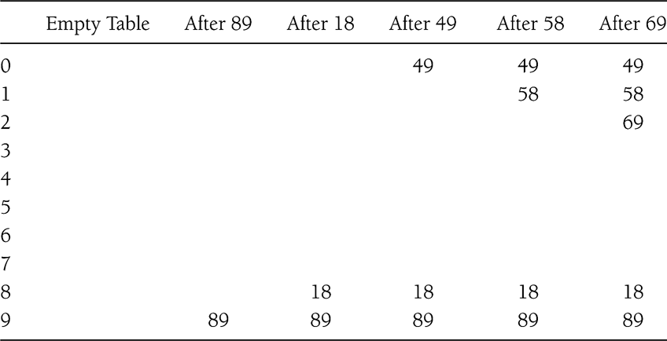
Linear Probing Example Contd.
Insert 89, 18, 49, 58, 69

Slide 5
Clustering problem
0 | 49
1 | 58
2 | 69
3
4
5
6
7
8 | 18
9 | 89
clustering: nodes being placed close together by probing, which degrades hash table's performance
  add 89, 18, 49, 58, 69

Slide 6
Quadratic probing
quadratic probing: resolving collisions on slot i by putting the colliding element into slot i+1, i+4, i+9, i+16, ...
  add 89, 18, 49, 58, 69
    49 collides (89 is already there), so we search ahead by +1 to empty slot 0
    58 collides (18 is already there), so we search ahead by +1 to occupied slot 9, then +4 to empty slot 2
    9 collides (89 is already there), so we search ahead by +1 to occupied slot 0, then +4 to empty slot 3
  clustering is reduced

Slide 7
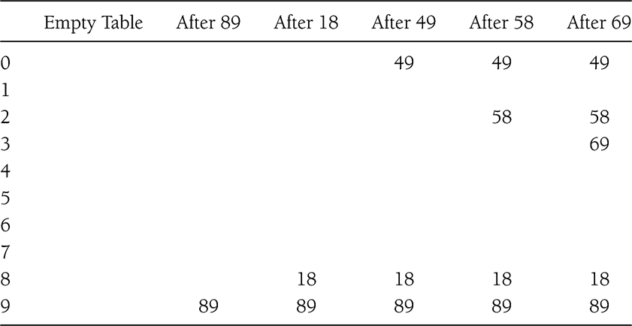
Quadratic probing Example Contd.
F(i) = i²
  Add 89, 18, 49, 58, 69

Slide 8
Type Declaration for Open addressing hash tables
typedef unsigned int index;
typedef index position;
typedef struct hashtbl *hashtable;
enum kindofentry {legitimate, empty, deleted};
struct hashentry
{
elementtype element;
enum kindofentry info;
};
typedef struct hashentry cell;
struct hashtbl
{
int tablesize;
cell *thecells;
};

Slide 9
Routine to initialize open addressing hash table
hashtable initializetable(int tablesize)
{
hashtable h;
int i;
if(tablesize < mintablesize)
{
Error(“Table size too small”);
return NULL;
}
h=malloc(sizeof(struct hashtbl));
if(h==NULL)
FatalError(“Out of Space”);
h->tablesize=nextprime(tablesize);
h->thecells=malloc(sizeof(cell) * h->tablesize);
if(h->thelists==NULL)
Fatalerror(“Out of space”);
for(i=0;i<h->tablesize;i++)
h->thecells[i].info = empty;
return h;
}

Slide 10
Insert routine for hash tables with quadratic probing
void insert(elementtype key, hashtable h)
{
position pos;
pos=find(key,h);
if(h->thecells[pos].info!=legitimate)
{
h->thecells[pos].info=legitimate;
h->thecells[pos].element=key;
}
}

Slide 11
Find routine for hashing with Quadratic Probing
position find(elementtype key, hashtable h)
{
position currentpos;
int collisionnum;
collisionnum=0;
currentpos=hash(key,h->tablesize);
while(h->thecells[currentpos].info!=empty
&& h-> thecells[currentpos].element != key)
{
currentpos+=2* ++collisionnum -1;
if(currentpos>=h->tablesize)
currentpos % = h->tablesize;
}
return currentpos;
}

Slide 12
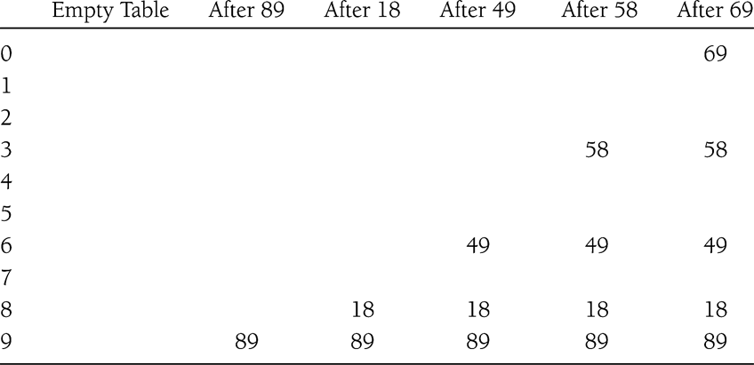
Double Hashing
f(i)=i * hash₂(x) where hash₂(x)= R – (X mod R)
where R is prime smaller than tablesize
E.g.: Let tablesize = 10. hash₂(x) = 7 – (x % 7)

